Slide 1
PointPillars: Fast Encoders for Object Detection from Point Clouds
Alex H. Lang, Sourabh Vora, Holger Caesar, Lubing Zhou, Jiong Yang, Oscar Beijbom

Slide 2
Outline
Introduction
Contribution
PointPillars Network
Network Architecture
Loss
Experiments
Conclusion

Slide 3
Introduction (1 / 3)
Lidar를 이용한 3D 객체 검출
MV3D : Image + Lidar → hand-crafted features → 3D detection
Hand-crafted → 정보 소실
3개의 backbone → 무거움
VoxelNet
LiDAR → Voxelize → Voxel-wise features → 3D CNN → RPN → 3D detection
3D CNN → 많은 연산량
Direction 성능 낮음
Frustrum-PointNet
RGD-D → 2D detection → 3D detection
Multi Stage → 과정 복잡
SECOND
VoxelNet’s 3D CNN to Sparse 3D CNN
3D CNN → 많은 연산량

Slide 4
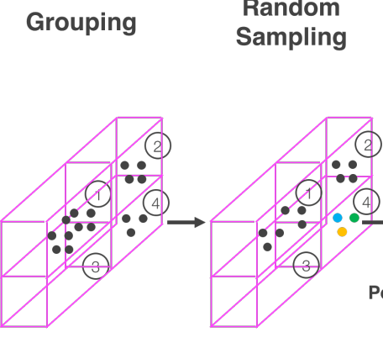
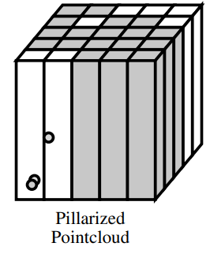
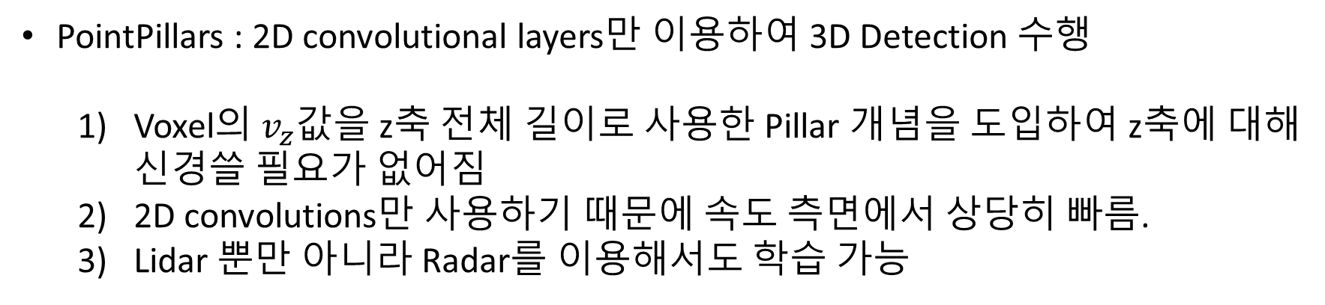
Introduction (2 / 3)
PointPillars : 2D convolutional layers만 이용하여 3D Detection 수행
Voxel의 $v_{z}$값을 z축 전체 길이로 사용한 Pillar 개념을 도입하여 z축에 대해 신경쓸 필요가 없어짐
2D convolutions만 사용하기 때문에 속도 측면에서 상당히 빠름.
Lidar 뿐만 아니라 Radar를 이용해서도 학습 가능

Slide 5
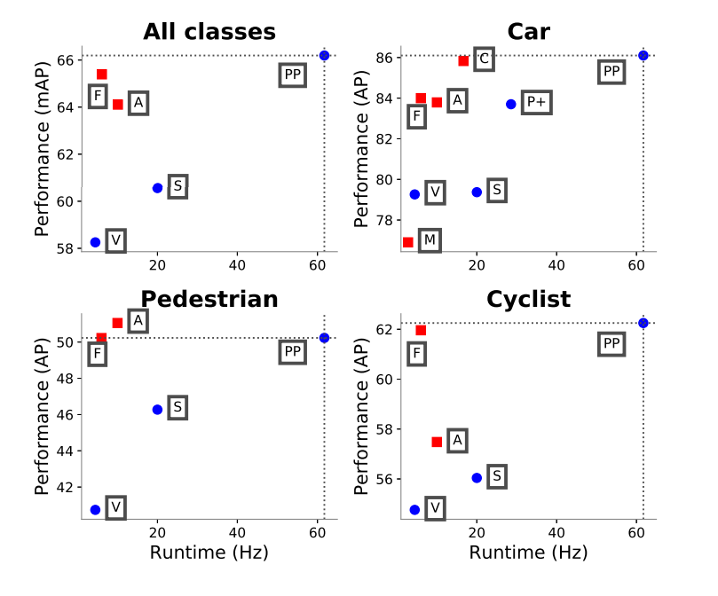
Introduction (3 / 4)
Lidar point clouds만 사용
기존의 Lidar 혹은 Lidar + image 기반 모델만큼의 성능 + 더 빠른 속도(기존의 2-4배)

Slide 6
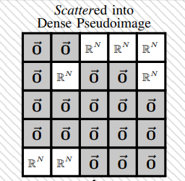
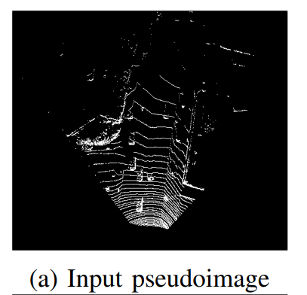
Contribution
Pillar라는 개념을 도입 + end-to-end training
Pillars feature networ를 거치고 나면 2D 형태의 pseudo image를 이용하여 2D CNN → 연산 속도 향상
State of the art(SOTA) on cars, pedestrians, and cyclists on both BEV and 3D benchmarks.
Ablation Studies를 통해 성능 향상에 중요한 요인 분석

Slide 7
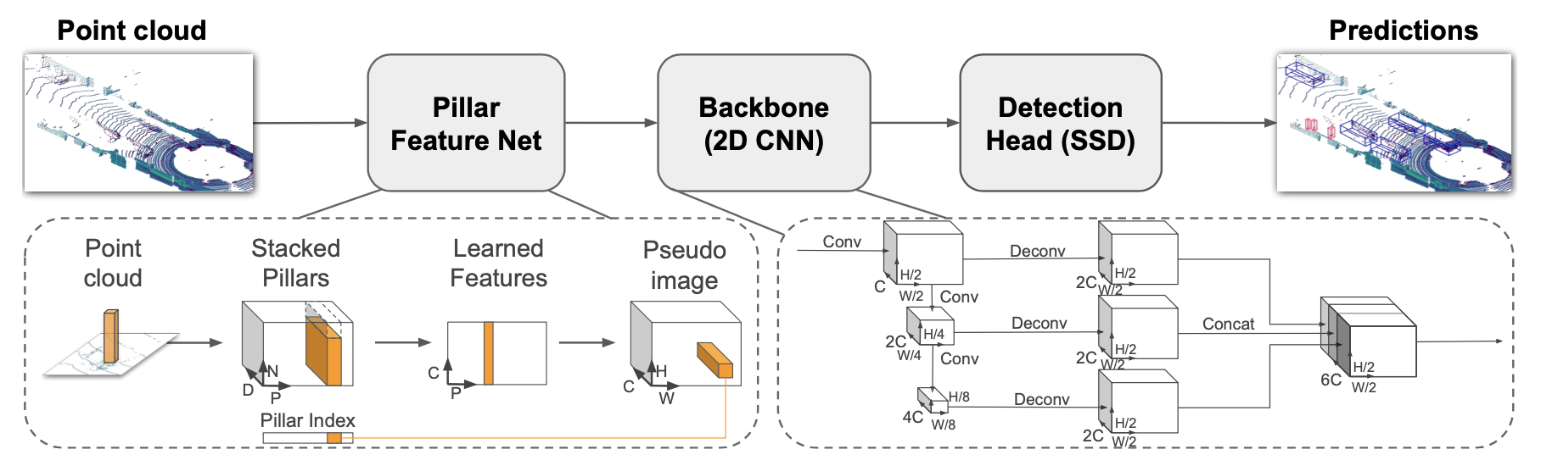
PointPillars Network (1 / 9)
Network Architecture
Pillar
Feature Net
Backbone
(2D CNN)
Detection Head (SSD)
3 Components
Pointcloud to Pseudo-Image
2D convolution Backbone
Detection Head

Slide 8
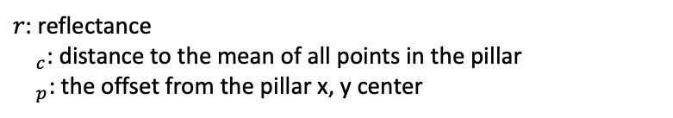
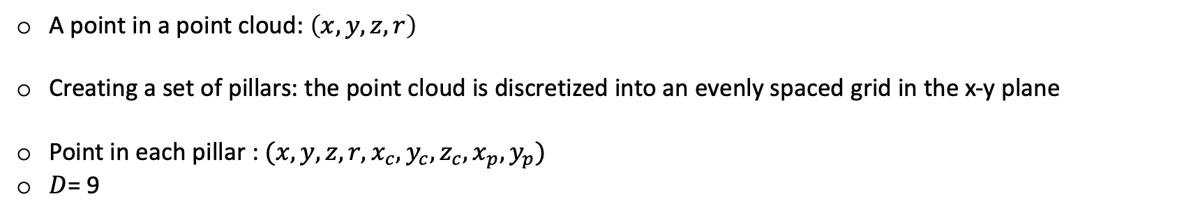
PointPillars Network (2 / 9)
Pointcloud to Pseudo-Image
A point in a point cloud: $\left(x, y,z,r\right)$
Creating a set of pillars: the point cloud is discretized into an evenly spaced grid in the x-y plane
Point in each pillar : $(x, y, z, r, x_{c}, y_{c}, z_{c}, x_{p}, y_{p})$
$D$= 9
$r$: reflectance
${}_{c}$: distance to the mean of all points in the pillar
${}_{p}$: the offset from the pillar x, y center

Slide 9
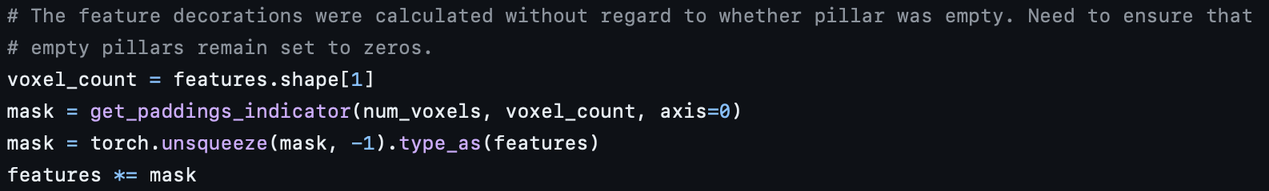

PointPillars Network (3 / 9)
Pointcloud to Pseudo-Image
The set of pillars will be mostly empty due to sparsity of the point cloud
Creating a dense tensor: imposing a limit both on the number of non-empty pillars per sample $\left(P\right)$ and on the number of points per pillar $\left(N\right)$
Sample or pillar holds too much data: random sampling
Sample or pillar holds too little data: zero padding

Slide 10
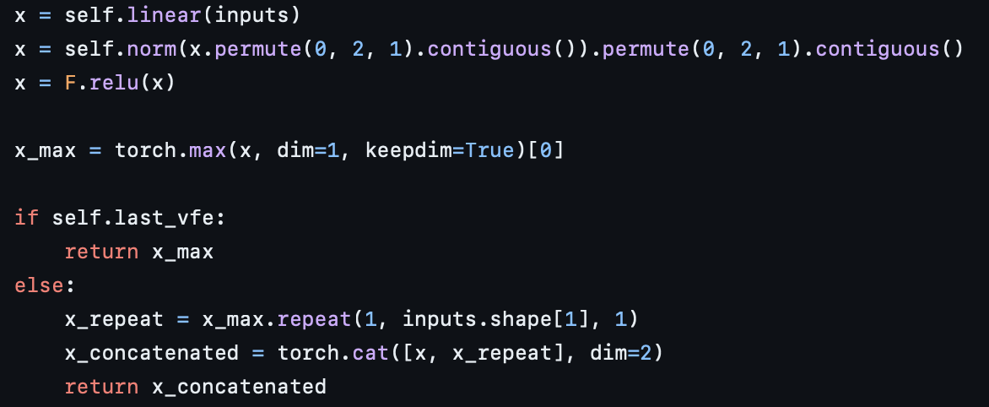
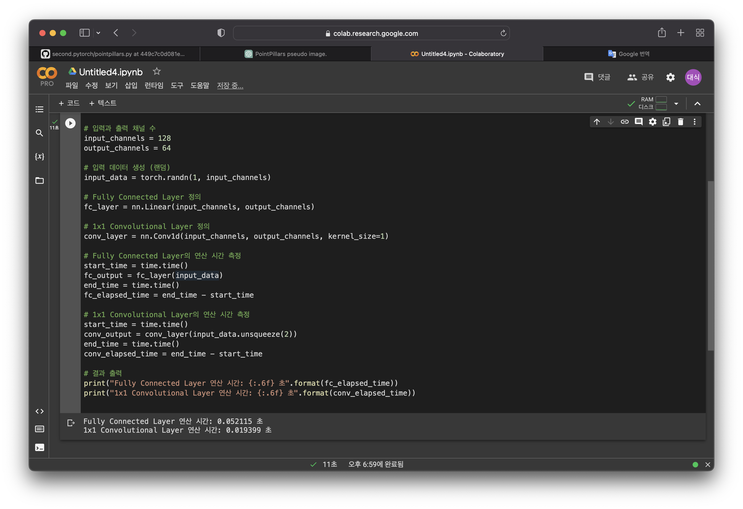
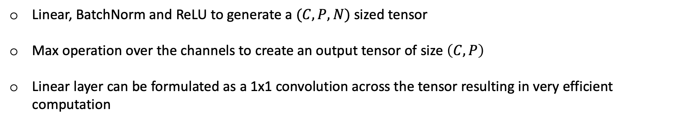
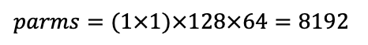
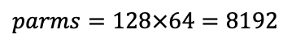
PointPillars Network (4 / 9)
Pointcloud to Pseudo-Image
Linear, BatchNorm and ReLU to generate a $(C, P, N)$sized tensor
Max operation over the channels to create an output tensor of size $\left(C, P\right)$
Linear layer can be formulated as a 1x1 convolution across the tensor resulting in very efficient computation
Input channel: 128
Output channel: 64
Linear layer
$$parms=128×64=8192$$
1X1 conv
$$parms=(1×1)×128×64=8192$$

Slide 11
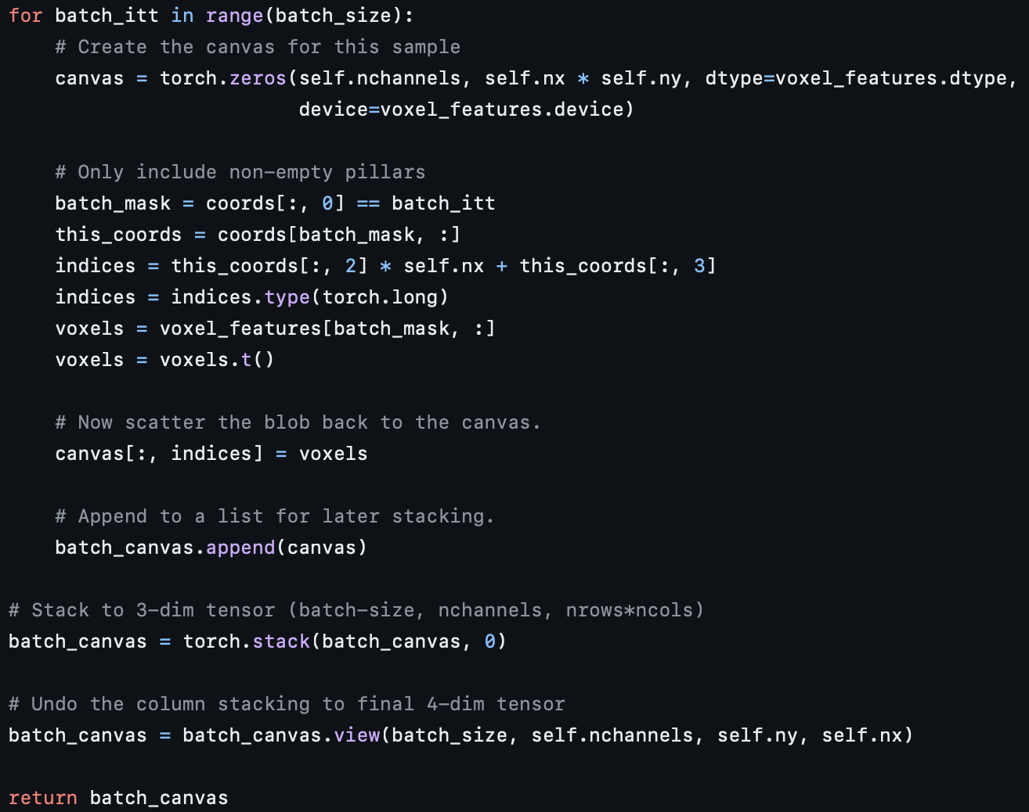
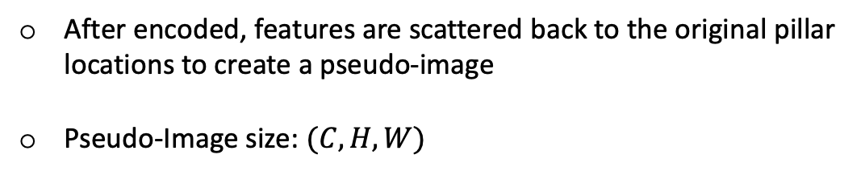
PointPillars Network (5 / 9)
Pointcloud to Pseudo-Image
After encoded, features are scattered back to the original pillar locations to create a pseudo-image
Pseudo-Image size: $(C,H,W)$

Slide 12
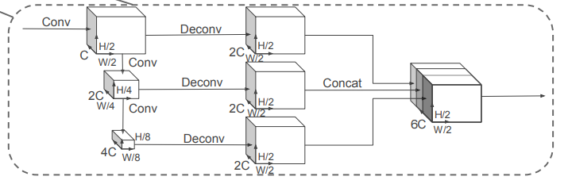
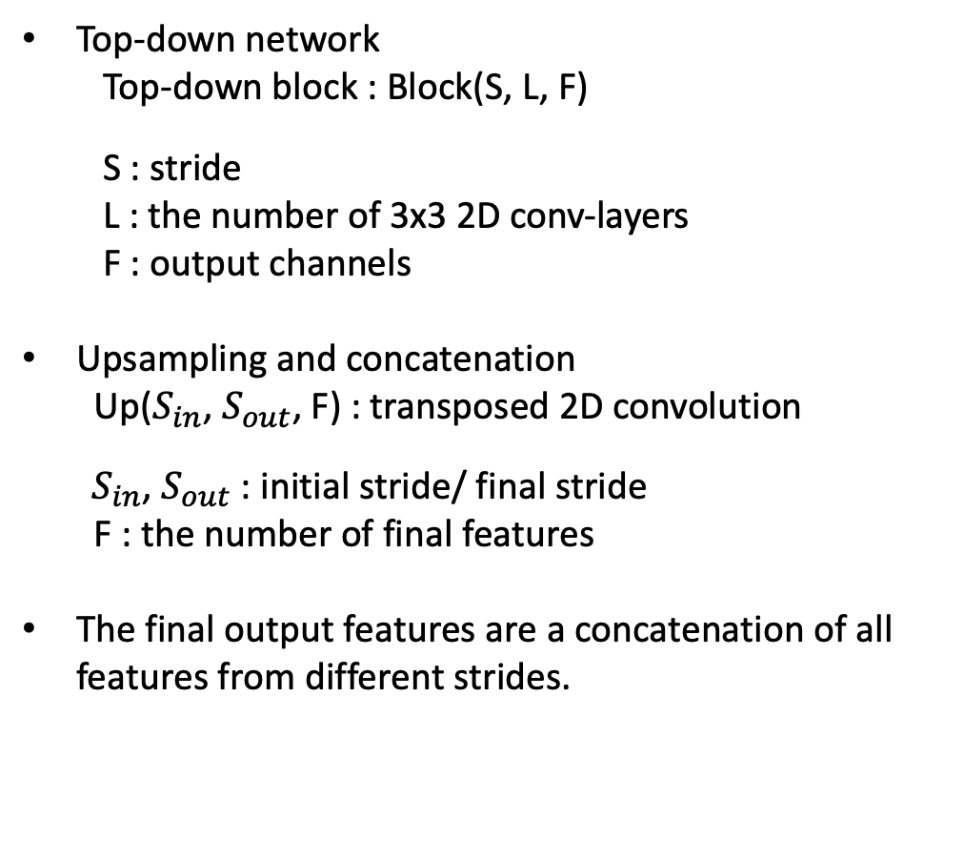
PointPillars Network (6 / 9)
Backbone
Top-down network
Top-down block : Block(S, L, F)
S : stride
L : the number of 3x3 2D conv-layers
F : output channels
Upsampling and concatenation
Up($S_{in}$, $S_{out}$, F) : transposed 2D convolution
${ S}_{in}$, $S_{out}$ : initial stride/ final stride
F : the number of final features
The final output features are a concatenation of all features from different strides.
1
2

Slide 13
PointPillars Network (7 / 9)
Network Details
 | Car | Pedestian & Cyclist
weights | initialized randomly using a uniform distribution as in Delving deep into rectifiers
C (= output features) | 64
stride of the first block | S = 2 | S = 1
Top – down block | Block1(S, 4, C), Block2(2S, 6, 2C), and Block3(4S, 6, 4C)
Upsampling | Up1(S, S, 2C), Up2(2S, S, 2C) and Up3(4S, S, 2C)
Then the features of Up1, Up2 and Up3 are concatenated together to create 6C features for the detection head.

Slide 14
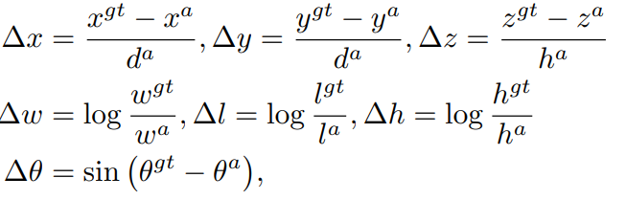
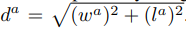
PointPillars Network (8 / 9)
Loss
Same loss functions introduced in SECOND
Ground truth boxes and anchors are defined by (x, y, z, w, l, h, θ).

Slide 15
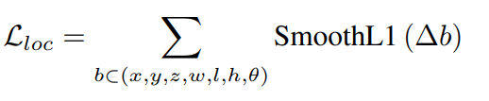
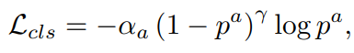
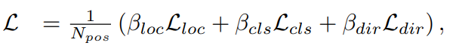
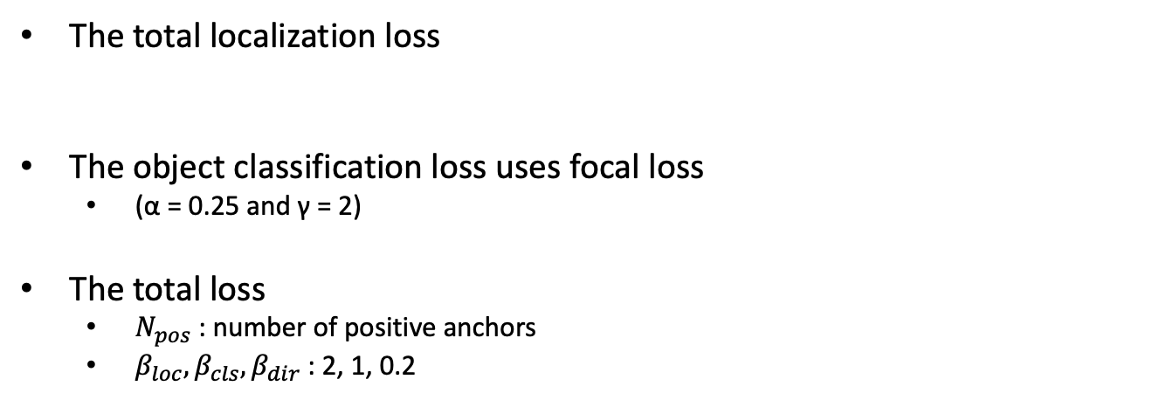
PointPillars Network (9 / 9)
Loss
The total localization loss
The object classification loss uses focal loss
(α = 0.25 and γ = 2)
The total loss
$N_{pos}$ : number of positive anchors
$β_{loc}, β_{cls}, β_{dir}$ : 2, 1, 0.2

Slide 16
Experiments (1 / 13)
Evaluation Conditions
Train Dataset : KITTI dataset
Train : Val = 1 : 1 (3712 : 3769)
Class : Car, Pedestrian and Cyclist
Level : easy, moderate and hard (⇒ the object height in the 2D results, occlusion and truncation)
Train Optimizer : Adam
Initial learning rate : 0.0002
Decay weight : 0.8 every 15 epochs
Epoch : 160 / 320 (val and test)
Batchsize : 2 / 4 (val and test)

Slide 17
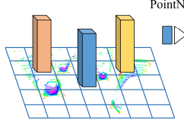
Experiments (2 / 13)
Settings
100 points
0.16m
xy resolution: 0.16 m
max number of pillars (P): 12000 = H X W, # of Grids
max number of points per pillar (N): 100
Same anchors and matching strategy as VoxelNet
width, length, height, and z center, and is applied at two orientations: 0 and 90 degrees.
0.16m
H
W
 | Car | Pedestrian & Cyclist
(x, y, z) boundaries range | [(0, 70.4), (-40, 40), (-3, 1)] (m) | [(0, 48), (-20, 20), (-2.5, 0.5)] (m)
Anchor range (w, h, l) | (1.6, 3.9, 1.5) (m) | (0.6, 0.8, 1.73) / (0.6, 1.76, 1.73) (m)
Anchor’s z center | -1 (m) | -0.6 (m)
positive and negative threshold | 0.6 and 0.45 | 0.5 and 0.3

Slide 18
Experiments (3 / 13)
Data Augmentation
Method 1
SECOND와 동일하게 모든 class들의 GT boxes와 그 안에 들어 있는 point들에 대해 Lookup table을 만들고 cars, pedestrians, and cyclists 각각에 대해 random하게 15, 0, 8로 선택하여 원래 point cloud에 추가함
15, 0, 8 for cars, pedestrians, and cyclists -> (Class imbalance)
Method 2 (ground truth boxes are individually augmented)
random rotation : uniformly drawn from [−π/20, π/20]
random transformation : translated (x, y, and z independently drawn from N (0, 0.25))
Method 3 (applied to the point cloud and all boxes)
random mirroring flip along the x axis
global rotation and scaling
global translation with x, y, z drawn from N (0, 0.2)

Slide 19
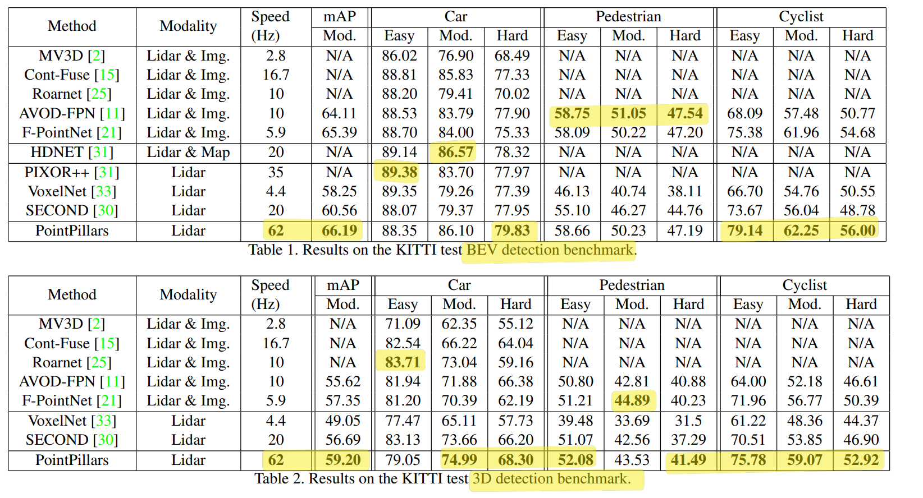
Experiments (4 / 13)
60Hz = 0.01667 seconds
30Hz = 0.03333 seconds
10Hz = 0.1 seconds
Results (Quantitative Analysis)
Outperform in mAP
Fastest
Compared to lidar-only methods, PointPillars achieves better results across all classes and difficulty strata except for the easy car stratum.
It also outperforms fusion based methods on cars and cyclists.
Average precision (AP) (in %) for 3D boxes in the KITTI validation set.

Slide 20
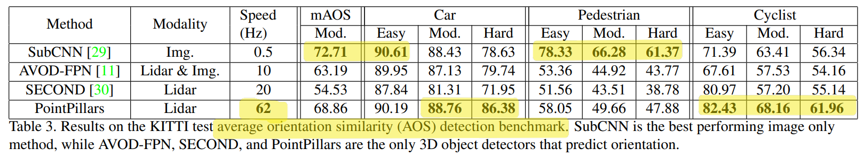
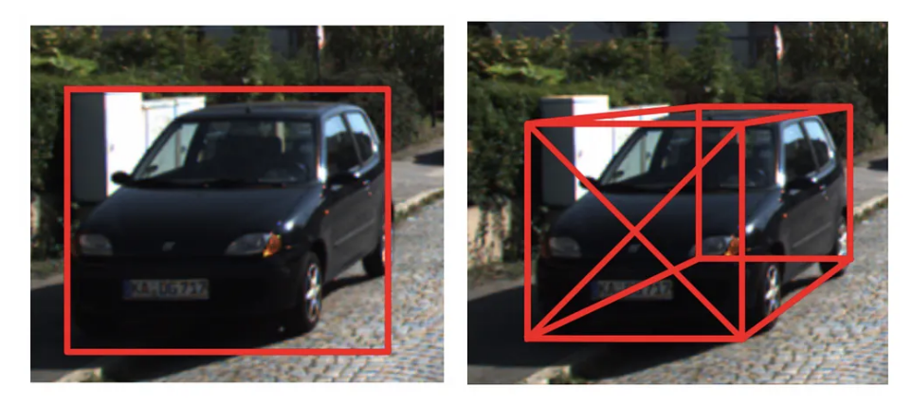
Experiments (5 / 13)
60Hz = 0.01667 seconds
20Hz = 0.05 seconds
10Hz = 0.1 seconds
Results (Quantitative Analysis)
SubCNN 성능을 이김
보통 3D로 detection을 수행하면 point cloud의 특성상 이미지로 2D detection을 수행하는 모델보다 성능이 낮을 수 밖에 없는데 PointPillars는 AOS 벤치마크에서 SubCNN의 성능을 뛰어 넘음
Average precision (AP) (in %) for 3D boxes in the KITTI validation set.
AOS(average orientation similarity)는 객체의 방향과 관련하여 예측 결과와 실제 결과 간의 유사성을 측정하는 평가 지표.
이미지는 2D고 point cloud는 3D임으로 직접적으로 방향을 예측할 수 있는 point cloud의 AOS가 더 좋은 건 당연

Slide 21
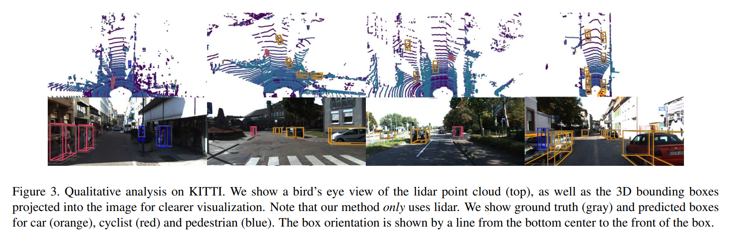
Experiments (6 / 13)
Results (Qualitative Analysis)
자동차에 대한 detection이 가장 좋았음.
가려져 있거나 멀리 있어 detect된 point 수가 적은 것들에 대해서는 False Negative로 잘못 예측함. 비슷한 class인 vans 또는 trams에 대해서도 False Positive로 잘못 예측함.

Slide 22
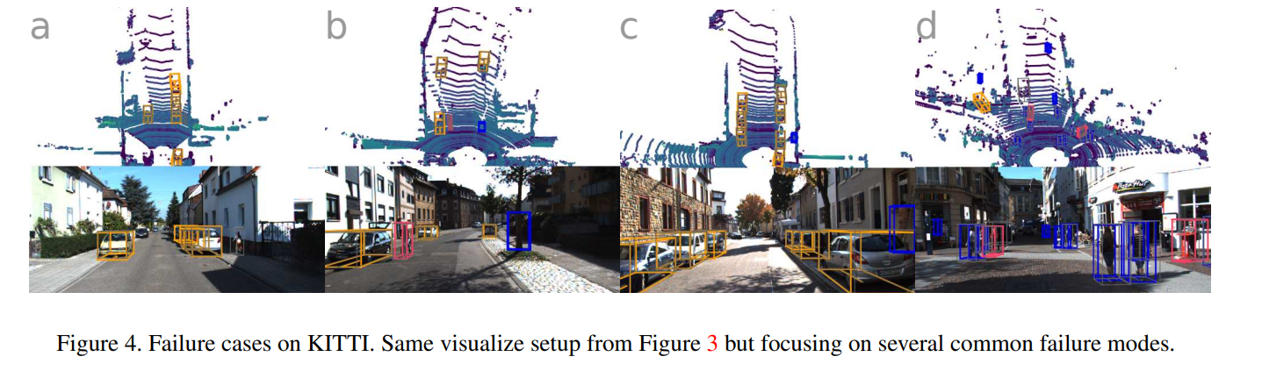
Experiments (7 / 13)
Results (Qualitative Analysis)
Pedestrians와 cyclists 는 보통 잘 분류하지 못함. (Figure 4a & 4d)
Pedestrians의 경우 수직으로 서 있는 구조물 또는 나무와 혼동되는 경우가 있음 (Figure 4b)
때로는 ground truth에는 없는 annotation들을 맞게 예측하기도 함 (Figure 4c)

Slide 23
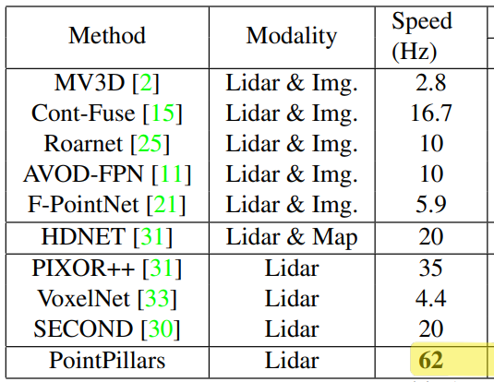
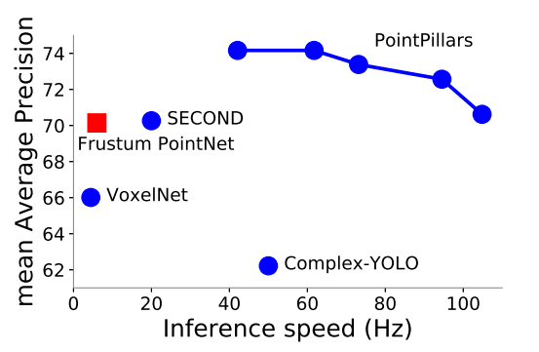
Experiments (8 / 13)
Realtime Inference
PointPillars represent a significant improvement in terms of inference runtime.

Slide 24
Experiments (8 / 13)
Realtime Inference
Desktop setting : Intel i7 CPU / 1080ti GPU
Loading point cloud and filtering based on range and visibility in images (1. 4ms)
Points are organized in pillars and decorated (2.7 ms)
PointPillar tensor is uploaded to the GPU (2.9 ms)
Encoded (1.3 ms)
Scattered to the pseudo-image (0.1 ms)
Processed by the backbone and detection heads (7.7 ms)
NMS is applied on the CPU (0.1 ms)
Total runtime : 16.2 ms

Slide 25
Experiments (9 / 13)
Realtime Inference
Encoding (1.3 ms)
The key design to enable this runtime is the PointPillar encoding.
Slimmer Design
The first block dimension was lowered to 64 to match the encoder output size
cutting the output dimensions of the upsampled feature layers by half to 128
TensorRT
45.5% speedup from the PyTorch pipeline which runs at 42.4 Hz

Slide 26
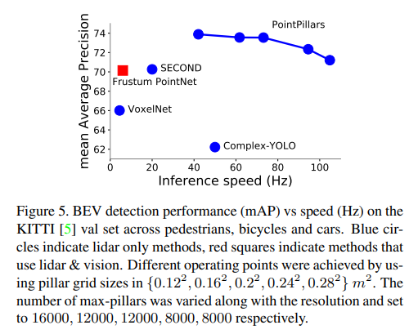
Experiments (10 / 13)
Ablation Study (Spatial Resolution)
Varying the size of the spatial binning provides a tradeoff between speed and accuracy.
Smaller pillars allow finer localization and lead to more features
Larger pillars are faster due to fewer non-empty pillars (speeding up the encoder) and a smaller pseudo-image (speeding up the CNN backbone)

Slide 27
Experiments (11 / 13)
Ablation Study (Per Box Data Augmentation)
Both VoxelNet and SECOND recommend extensive per box augmentation.
However, minimal box augmentation worked better.
Hypothesis is that the introduction of ground truth sampling mitigates the need for extensive per box augmentation.

Slide 28
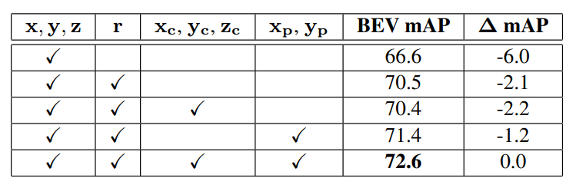
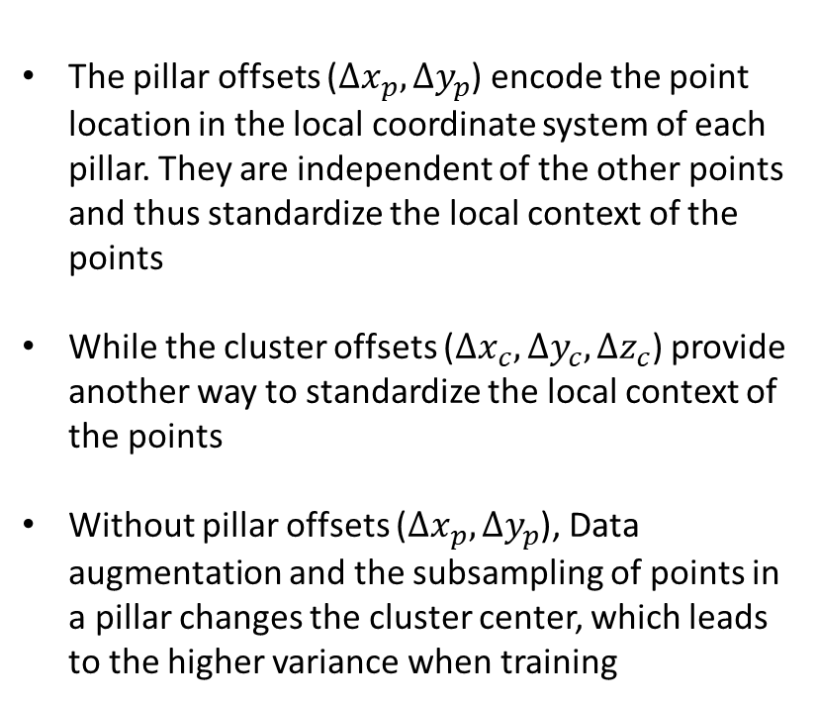
Experiments (12 / 13)
Ablation Study (Point Decorations)
The pillar offsets ($∆x_{p}, ∆y_{p}$) encode the point location in the local coordinate system of each pillar. They are independent of the other points and thus standardize the local context of the points
While the cluster offsets ($∆x_{c}, ∆y_{c}, ∆z_{c}$) provide another way to standardize the local context of the points
Without pillar offsets ($∆x_{p}, ∆y_{p}$), Data augmentation and the subsampling of points in a pillar changes the cluster center, which leads to the higher variance when training

Slide 29
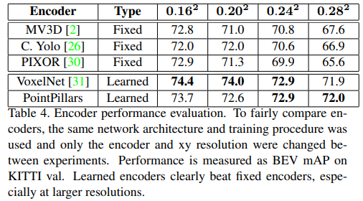
Experiments (13 / 13)
Ablation Study (Encoding)
Several encoders in the official codebase of SECOND
Learning the feature encoding is strictly superior to fixed encoders across all resolutions
At Similar inference time, it is clear that PointPillars offers a better operating point.

Slide 30
Conclusion
Summary
In this paper, we introduce PointPillars, a novel deep network and encoder that can be trained end-to-end on lidar point clouds.
PointPillars dominates all existing methods by offering higher detection performance (BEV and 3D mAP) at a faster speed
PointPillars offers the best architecture so far for 3D object detection from lidar.
Limitation
Timing measurements are typically done on a high-power desktop GPU. However, an operational AV may instead use embedded GPUs or embedded compute which will likely have lower throughput.

Slide 31
Thank you

